Slide 1
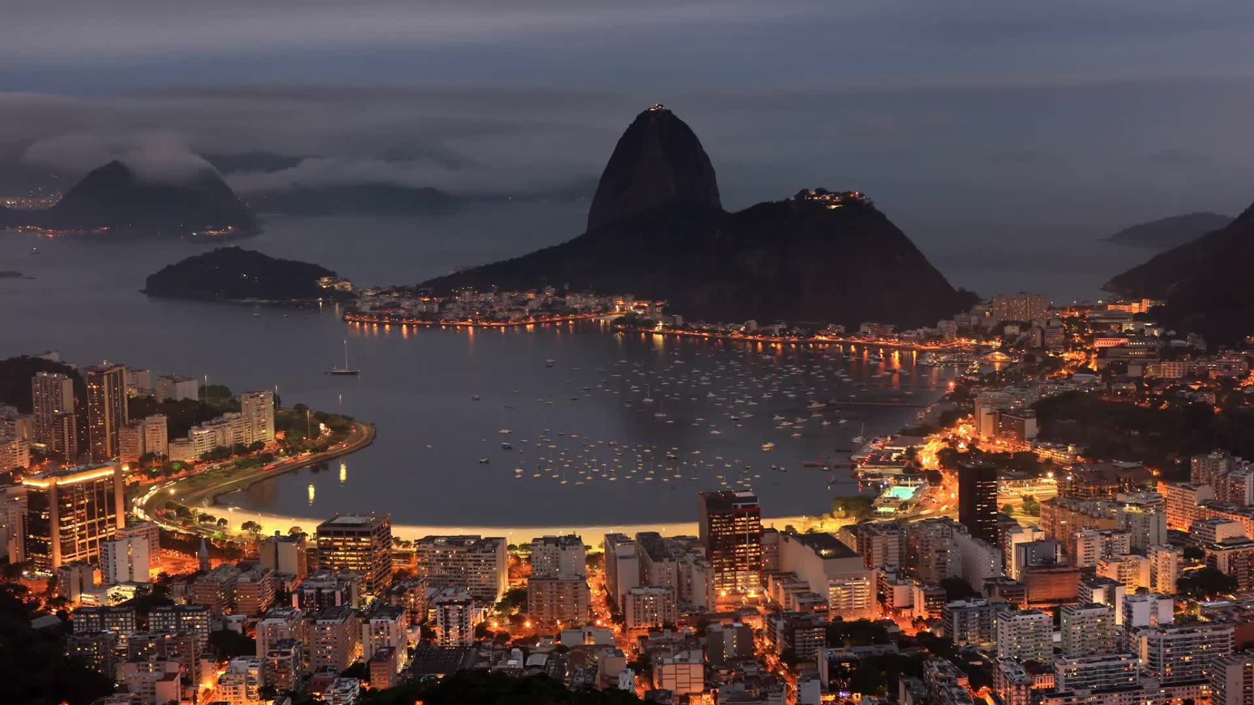
Nigeria- The giant of Africa
Brought to you By the fabulous four: Ishaan, Andy, Simon, Guy

Slide 2
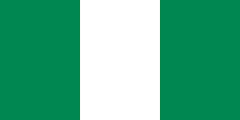
Introduction
Nigeria is a country known to many as the "African giant". From its rising tech industry to its yummy Jollof rice, Nigeria has a lot to offer. It has the largest African economy and population, and is the centre of many African industries, be it the oil industry, tech industry, music industry and film industry. There are s many things Nigeria lead in Africa that if we mentioned them all we'd be here ages. So without further ado, we'll show you how Nigeria lives up to its nickname " The giant of Africa".

Slide 3
Statistics
Nigeria is home to 232 million individuals
It has the largest economy in Africa
The capital is Abuja, yet the largest city is Lagos
The area is 923,768 km
Its currency is the Naira, and 2120 Naira is one pound.
It has the largest population as well at 232 million

Slide 4
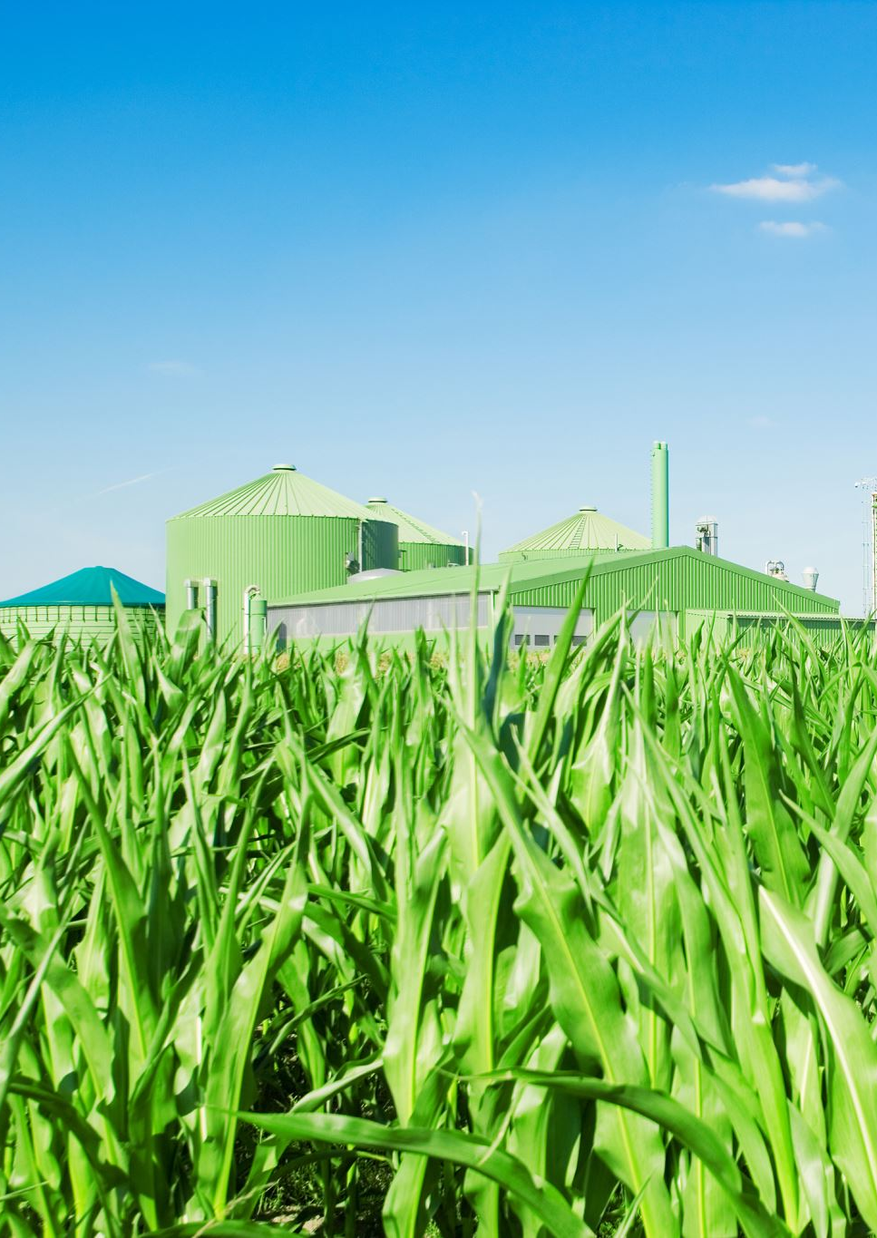
Economy
Nigeria is Africa's largest economy, worth an estimated $1.565 trillion! Nigeria's main source of income is the oil sector. It accounts for 95% of their exports, and 80% of the government revenue. Agriculture is also very important in Nigeria. It employs 36% of their workforce. Other important job sectors include the creative sector, which encompasses the food industry to the beauty industry. The tech sector is also a rising industry and you can expect it to become much larger in the future.

Slide 5

Population
Nigeria is home to 232 million people. About 54% of Nigeria live in urban settings, however 47% of Nigerians are living in poverty. This figure has been rising since 2018 due to inflation. On the other hand, Nigeria's unemployment rate has decreased to under 5%. Nigeria is expected to have an increasing workforce as the average age is 18 years.

Slide 6
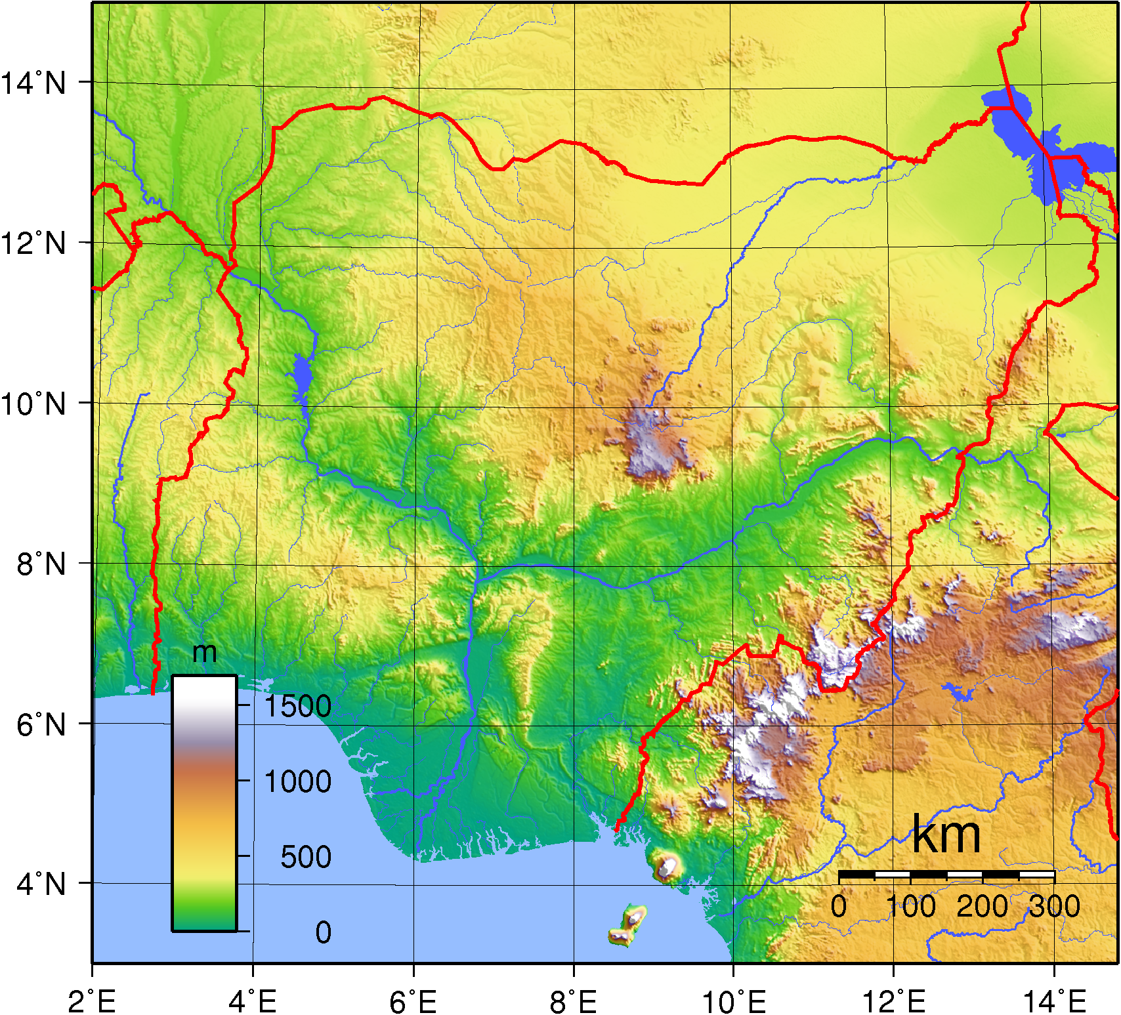
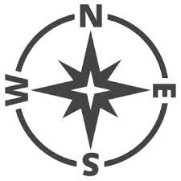
Location
Nigeria is located in west Africa, being bordered by Benin to the west, Chad and Cameroon to the east and Niger to the north. It is bordered by the gulf of Guinea to the south. The longitude and latitude is 9.0820° N, 8.6753° E .

Slide 7
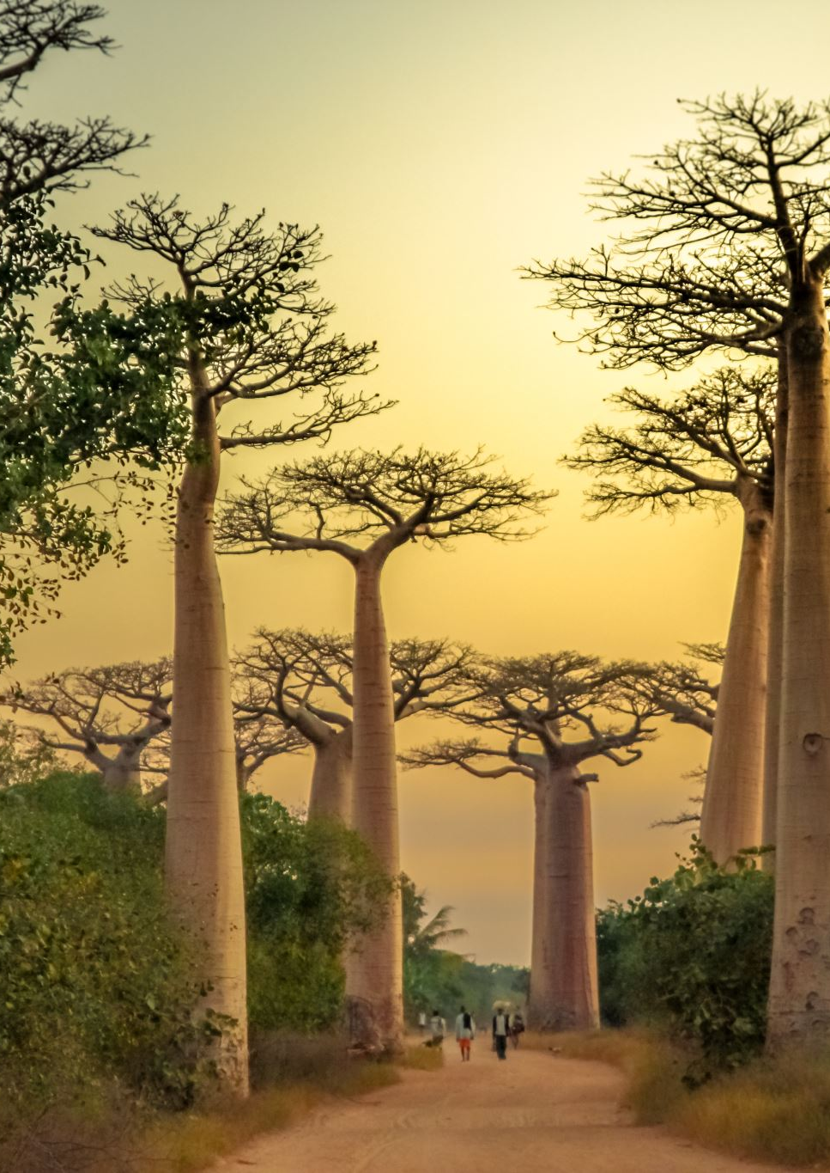
Biomes
Nigeria is home to many vast landscapes. Here are some of them:
Nigeria boasts a varied landscape, ranging from tropical rainforests in the south to semi-desert regions in the north. The country is known for extensive river systems, including the Niger River and its extensive delta, one of the largest in the world. It also features plains, savannas, and mountainous areas.

Slide 8
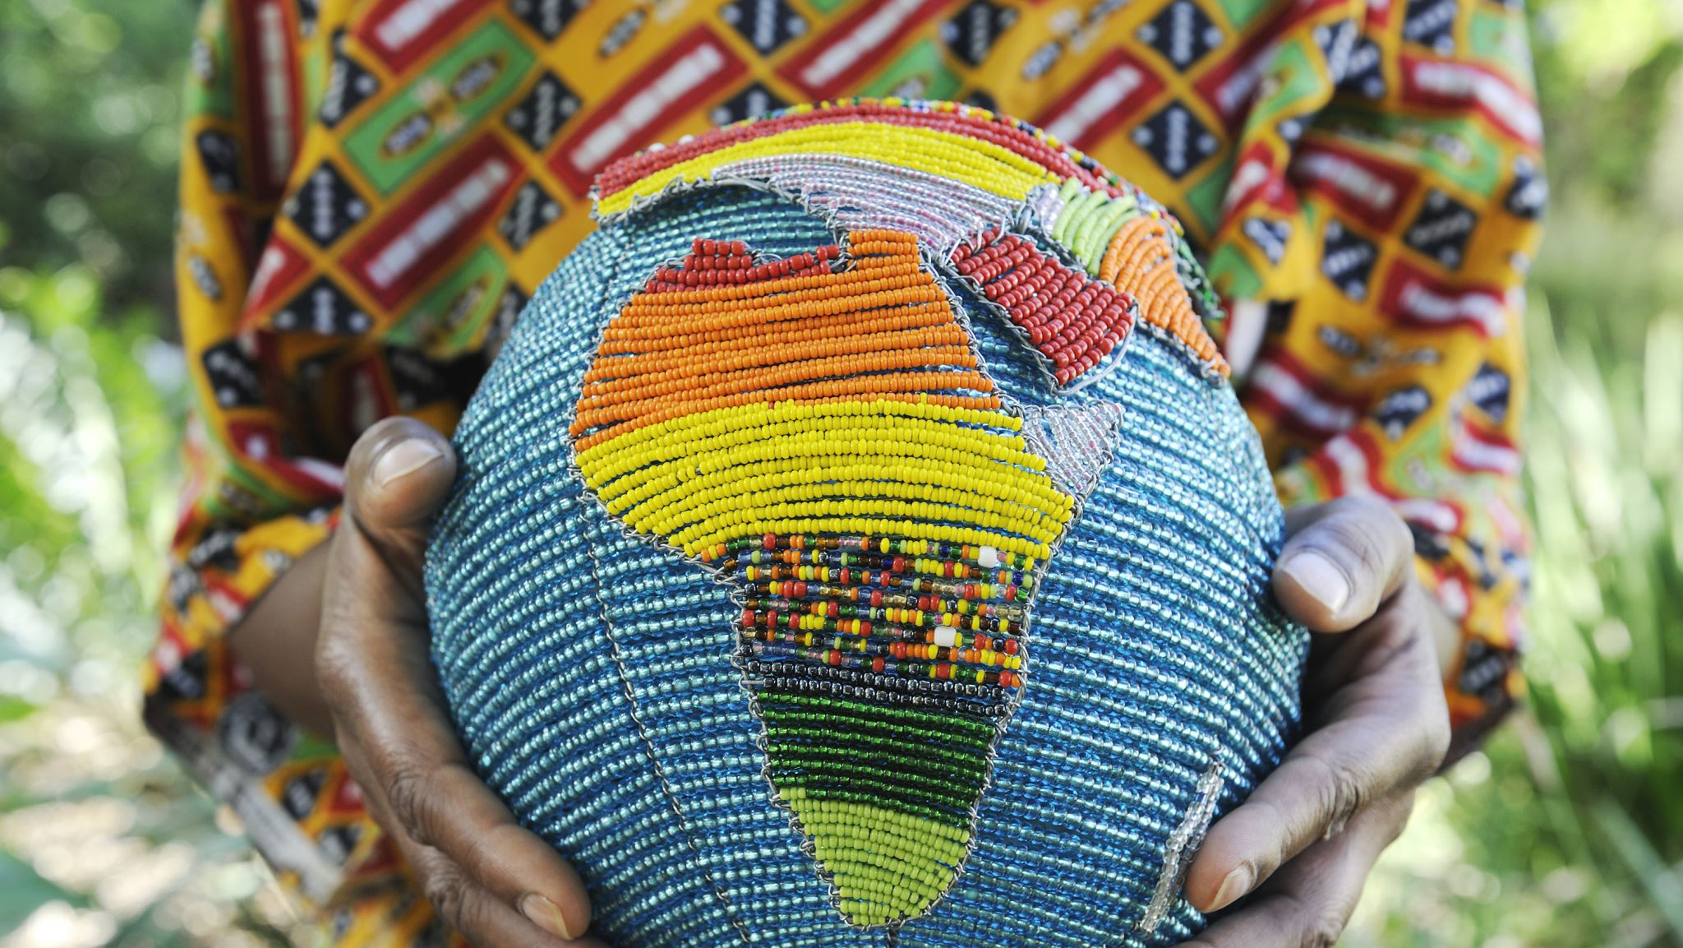
Ethnicities
Nigeria is a very diverse country in terms of ethnicities. It has over 500 native tounges and ethnicites. The main language is Hausa in the north, Yoruba in the southwest and Igbo in the southeast, but the official language is English.

Slide 9
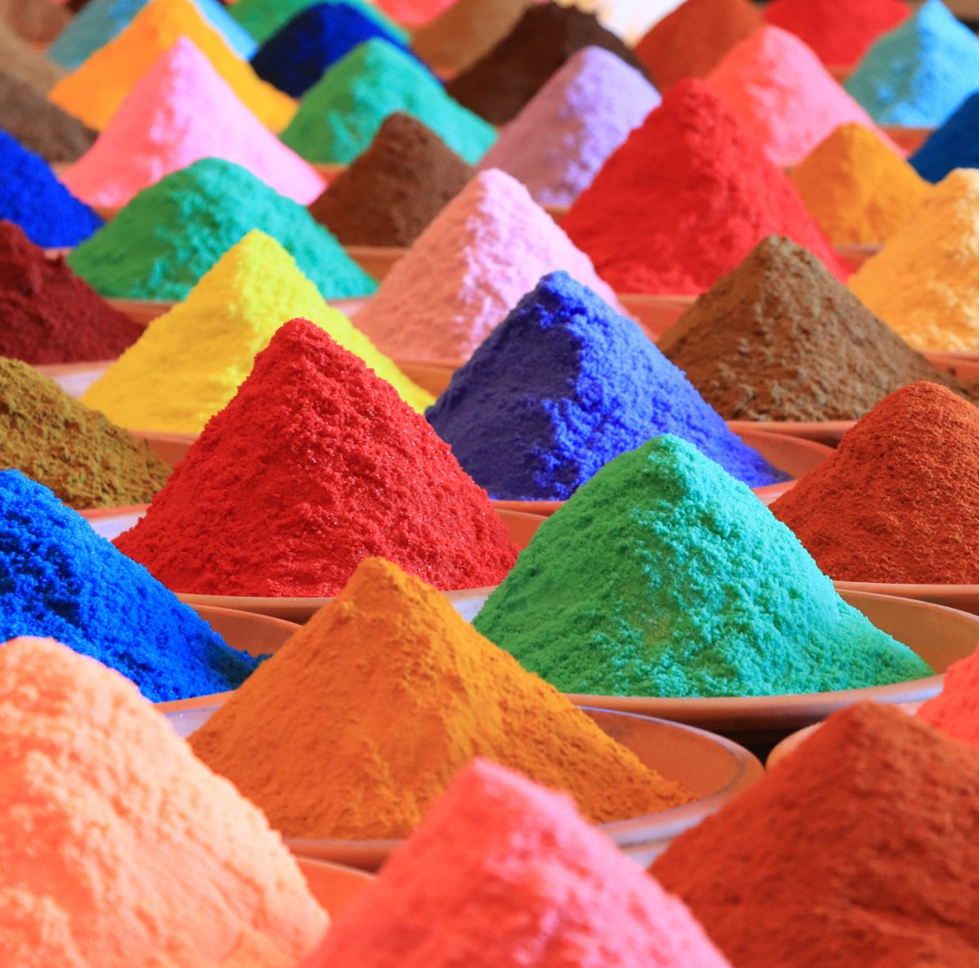
Culture Nigerian culture is lively and full of color. Music and dance are very important, with styles like Afrobeat and Fuji being popular. People enjoy tasty foods like Jollof rice, Suya, and Egusi soup, made with local spices. Big festivals like the Calabar Carnival and the Osun-Osogbo Festival celebrate tradition, music, and community. Clothes made from bright fabrics like Ankara are worn for special events. Religion is also important, with many people following Christianity, Islam, or traditional beliefs.

Slide 10
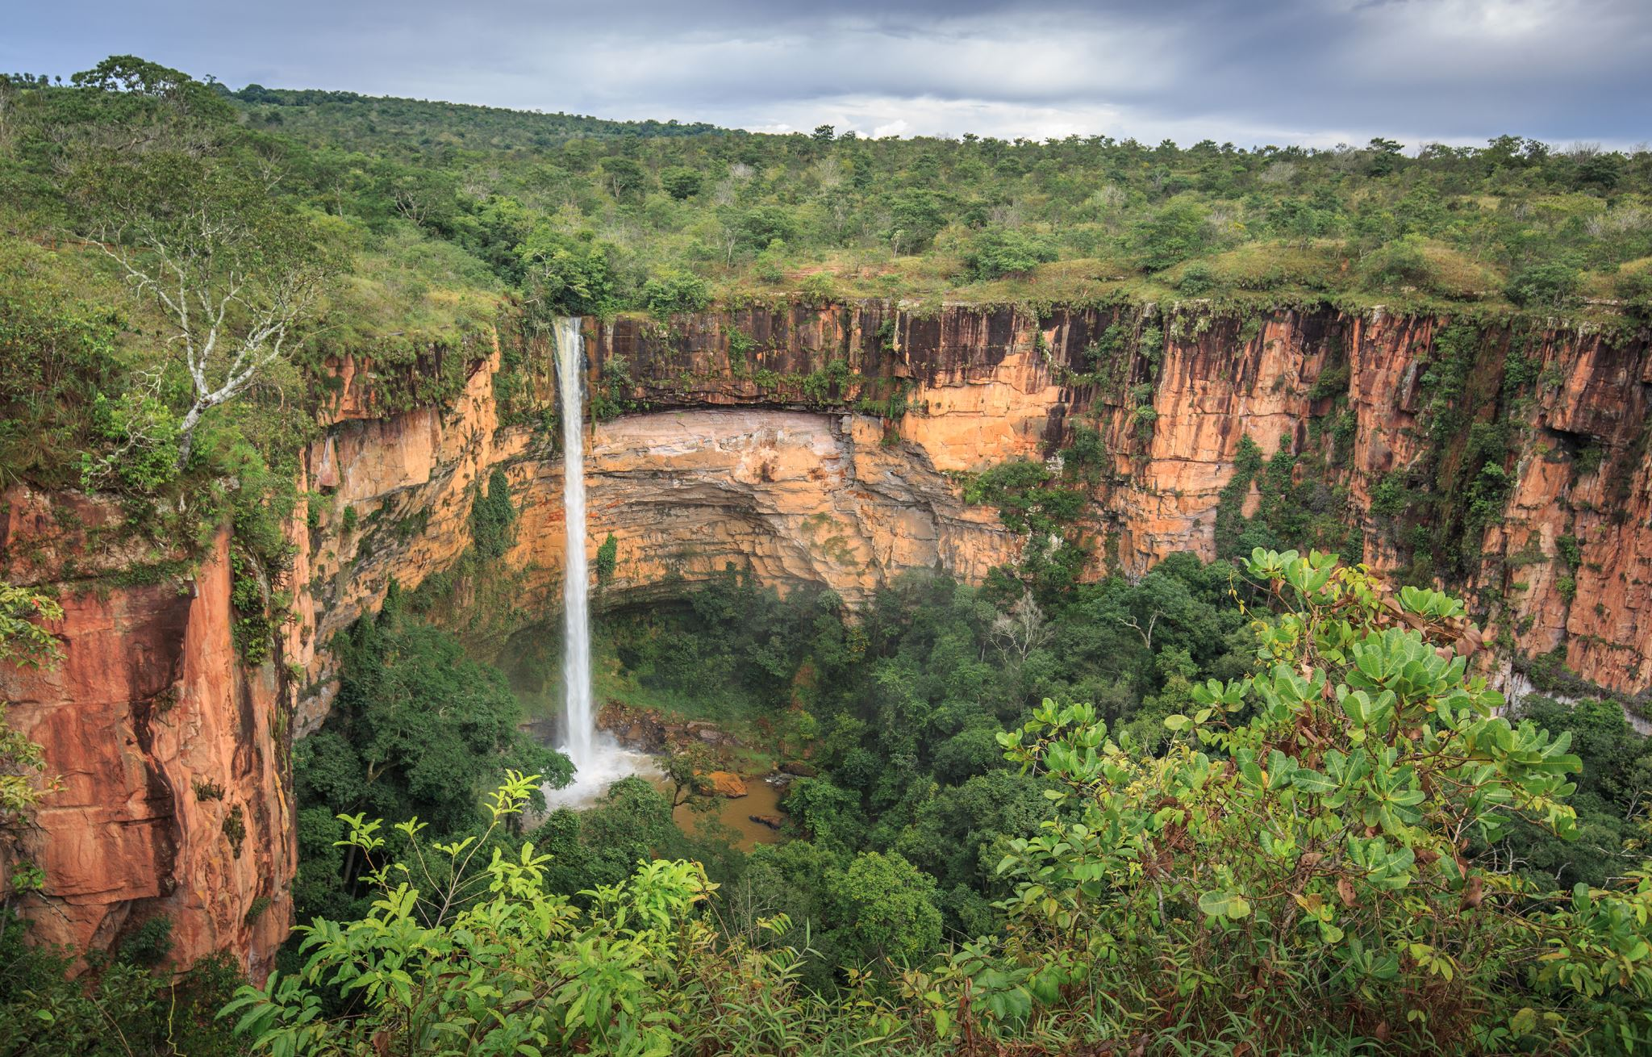
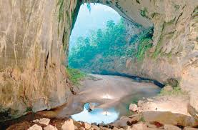
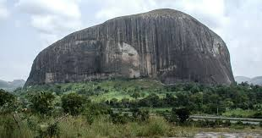
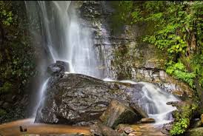
Places to visit (physical features)
Nigeria is a country with many amazing physical features. These locations are very popular with tourists.
Ogbunike Cave – This is a cave in the valley behind the Ogbunike Hills. This is popular for tourists in Anambra (a Nigerian state) and the Nkisa River flows near it.
Zuma Rock Often called the "Gateway to Abuja," Zuma Rock is a massive monolith standing at about 725 meters (2,379 feet) above its surroundings. It’s famous for its human-like facial features and spiritual significance to local communities.
Erin Ijesha Waterfall Also known as Olumirin Waterfalls, this stunning multi-level waterfall cascades through a lush forest. It offers both beauty and a mild hiking challenge, with seven levels of falls, each offering its own charm.

Slide 11
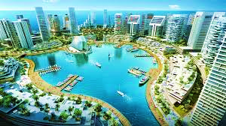
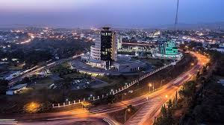
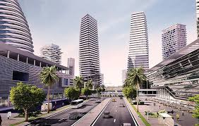
Nigerian cities
Lagos Nigeria’s largest city and commercial hub, Lagos is a vibrant metropolis known for its bustling markets, nightlife, beaches (like Tarkwa Bay and Elegushi), and cultural landmarks such as the Nike Art Gallery and the National Museum.
Abuja The capital city of Nigeria, Abuja is a planned city known for its modern architecture, wide roads, and political importance. Key attractions include Aso Rock, the National Mosque, and Millennium Park.
Calabar (Cross River State) Calabar is famous for its rich history, colonial architecture, and the annual Calabar Carnival, often called “Africa’s biggest street party.” It's also a gateway to natural attractions like the Cross River National Park and Obudu Mountain Resort.

Slide 12
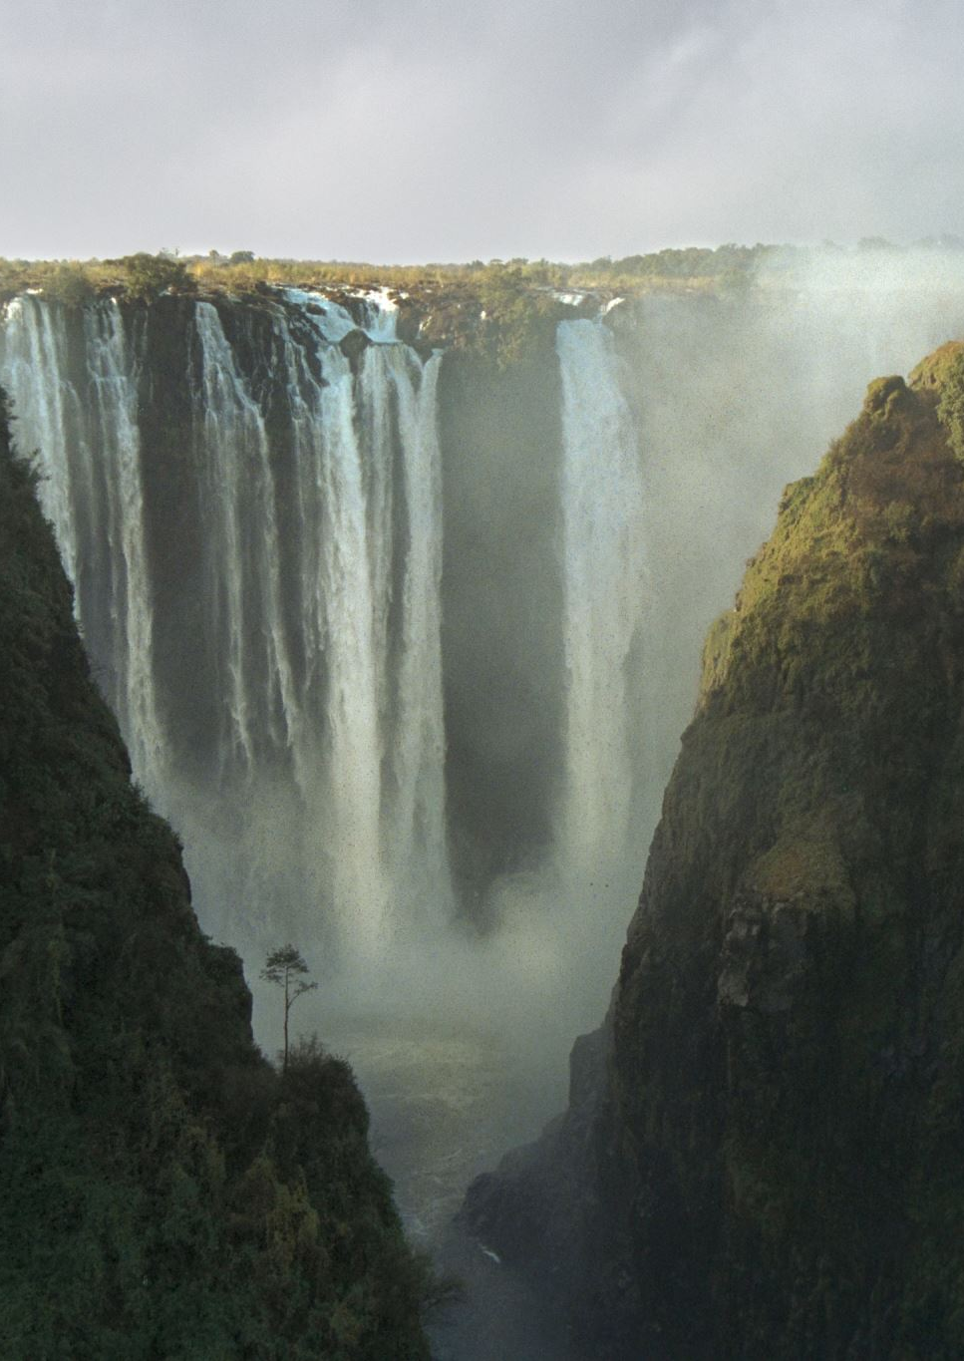
Why visit Nigeria?
Nigeria is a nation rich in diversity, culture and natural beauty. From stunning waterfalls to breathtaking clifftops, Nigeria never fails to meet the expectations for beauty no matter the region. Discover a rich heritage with over 500 ethnic groups and vibrant festivals like the Calabar carnival. Vibe with the beats of Nigeria's Afrobeats music and watch their film industry in awe. Nigeria won't leave you disappointed in the culture department. Explore dynamic cities like Lagos and Abuja, where tradition meets innovation, and experience the famed warmth and resilience of the Nigerian people. In conclusion, Nigeria is not just an amazing destination, it's an unforgettable experience.

Slide 13
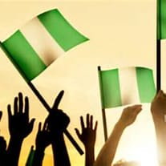
Commonwealth
Nigeria was occupied by the British from from the 19th century to 1960
Part of the independence deal was for Nigeria to become independent and join the commonwealth on October 1st 1960
This was partly because Britain and America both tried to prevent countries from becoming communist or becoming allies with the Soviet Union during the Cold War
Though it is still a Commonwealth country, Nigeria has not had the British Monarch as head of state since 1963, and instead has a president
Queen Elizabeth II first toured Nigeria on January 2nd 1956, before independence
Independence Day is celebrated in Nigeria on October 1st
Independence Day (or National Day) is a public holiday that includes a speech by the president, raising of the National flag to the singing of the National anthem and a military parade
Many people and organizations will also have their own celebrations, like parades

